Slide 1

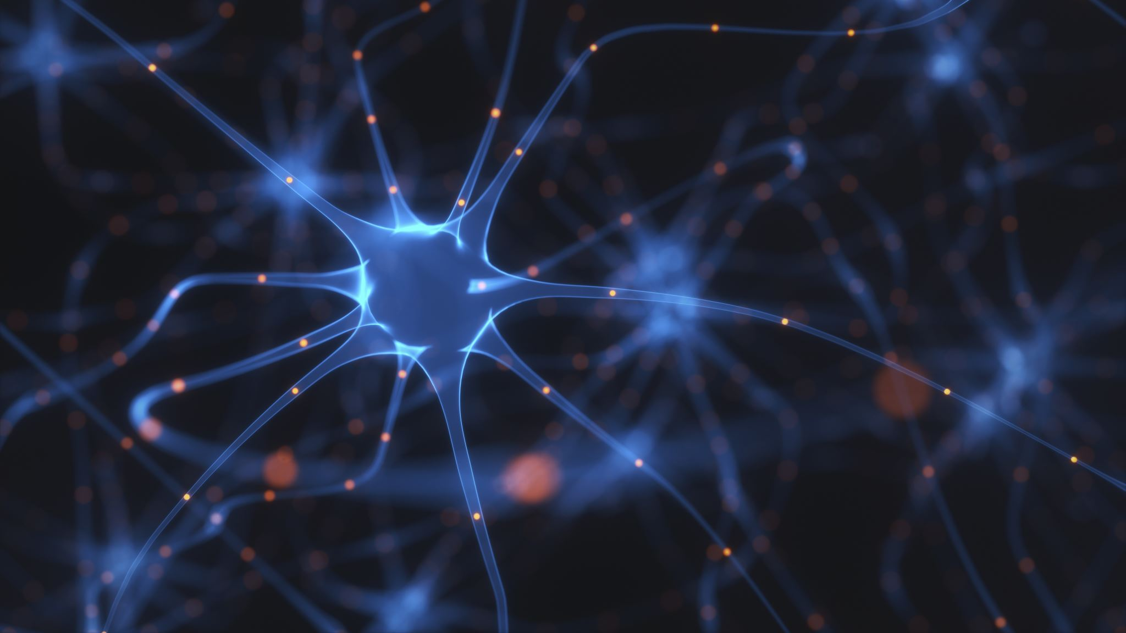
CNN (Convolutional Neural Network)
Welcome to this week’s Workshop
McMaster AI Society

Slide 2

What are we doing today?
A Quick Re-Cap of last workshop
New Topic Introduction
Application of Learning (Demo)
Kahoot for a Prize!!!

Slide 3
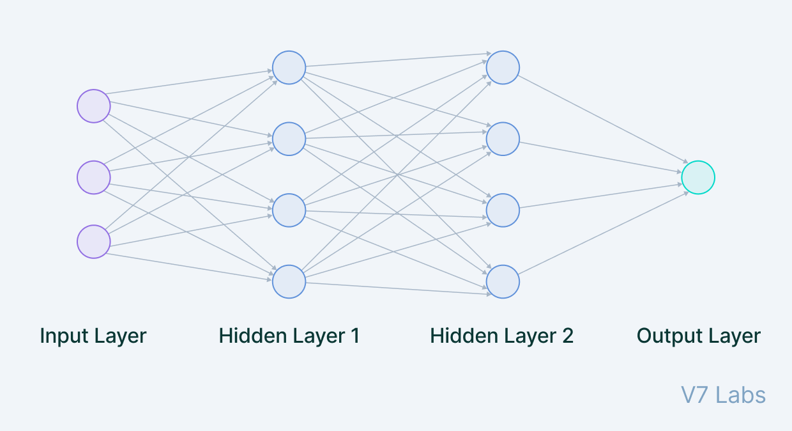

A quick recap
What is a Neural Network???
How does it work???
Where is it used???

Slide 4
Let’s get started
A Simple Introduction to Convolutional Neural Network

Slide 5
What is a CNN??
Simple Answer
A bit more info
Predominantly used to extract features from grid-like matrix dataset
Images → Complex
CNN → Simplifies
Deep Learning Neural Network typically used in Computer Vision
Has different layers than a normal Neural Network
Inspired by the visual cortex of the brain

Slide 6
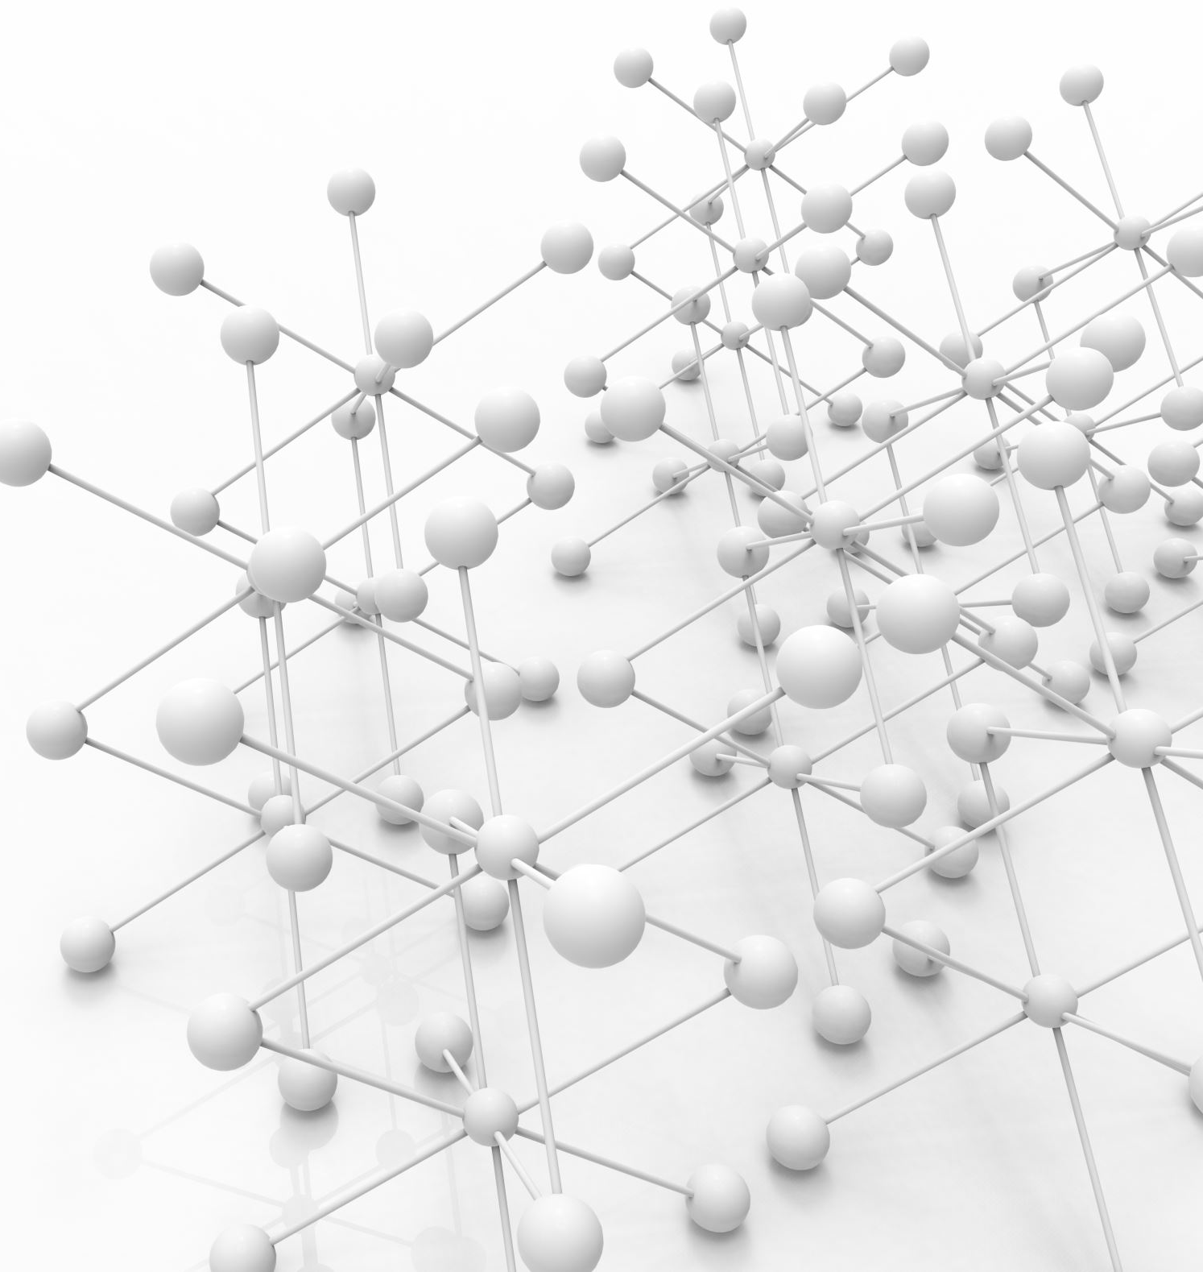
A deeper dive
Contains different layers than a normal Neural Network
In the next few slides, I will be explaining each layer

Slide 7
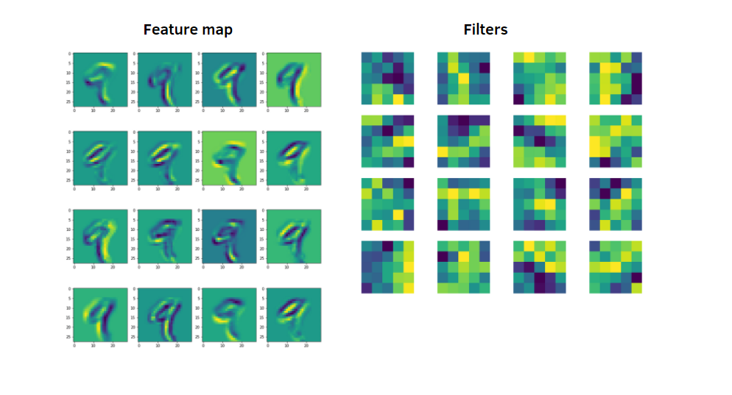
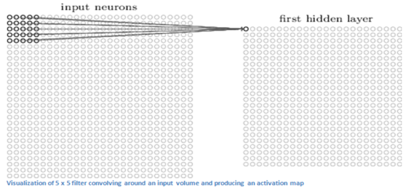
Convolutional Layer
Responsible to apply various filters (aka kernels) to input data
This kernel “slides” over input and computes dot product between kernel weight and corresponding image patch
This dot product is calculated every time the kernel shifts and the summation is mapped to a feature map

Slide 8
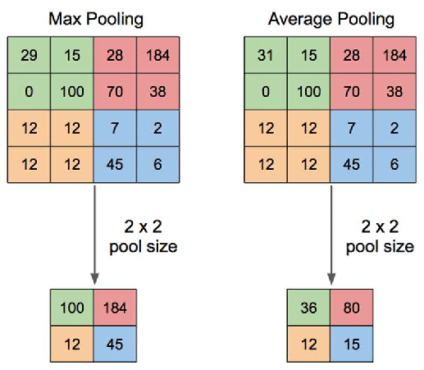
Pooling layer
Responsible to reduce sample size of a particular feature map
Increases processing as it reduces # of parameters the network needs to process
Output → Pooled feature map
2 Types ------------------------------->

Slide 9

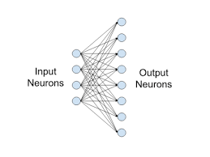
Fully connected layer
Responsible on performing classification
This should look familiar…
BUT, before this you need to flatten things out…Why?
Quick note about ReLu (Rectified Linear Unit)

Slide 10
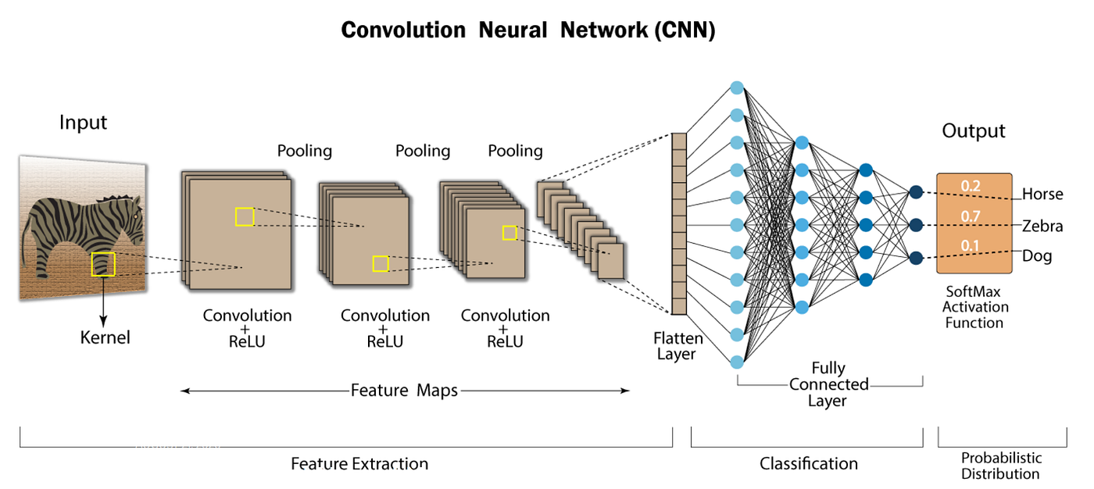

Slide 11
Let’s get into the demo
Link: https://github.com/ConnorUsaty/MacAIEducation2023

Slide 12
Kahoot
https://create.kahoot.it/share/convolutional-neural-network/2afe490f-eabd-4859-ab14-fdac31db49c7

Slide 13
